Slide 1


SMART INDIA HACKATHON 2024
TITLE PAGE
Problem Statement ID- 1637
Problem Statement Title- Mobile App for Direct Market access for Formers.
Theme- Agriculture , FoodTech & Rural Development
PS Category- Software/Hardware
Team ID-
Team Name (Registered on portal)

Slide 2

IDEA TITLE
Your Team Name
Proposed Solution (Describe yourIdea/Solution/Prototype)
Solution Overview: The proposed solution is a smart mobile app designed for farmers, integrating AI for predictive pricing. It enables farmers to list products, negotiate prices, and manage logistics seamlessly, reducing reliance on middlemen.
Problem Addressed: The app uses AI to predict market trends and suggest pricing, removing guesswork and dependence on intermediaries.
Innovation: The AI-driven, real-time pricing and market demand insights empower farmers to make informed decisions, a novel approach in agriculture.

Slide 3
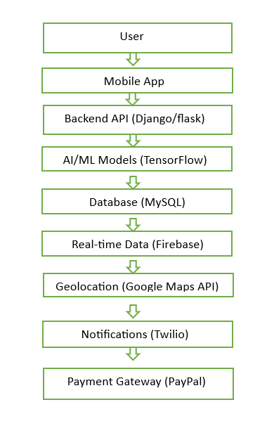
TECHNICAL APPROACH
Your Team Name
Technologies to be Used: Python for backend AI algorithms and more..
Frameworks: React Native for cross-platform compatibility and more..
Database: mysql for managing data.

Slide 4
FEASIBILITY AND VIABILITY
Your Team Name
Feasibility Analysis: The application is highly feasible due to advancements in AI and mobile technology.
AI models can leverage existing market data for training, and the app is scalable to various regions and crops.
Challenges and Risks:
Data Availability: Accessing accurate market data for AI models.
User Adoption: Gaining farmers’ trust in AI recommendations.
Infrastructure: Limited internet connectivity in rural areas.
Strategies:
Data: Partner with local markets for reliable data.
Training: Offer workshops and in-app tutorials for farmers.
Offline Use: Enable offline functionality with data syncing when connected

Slide 5
IMPACT AND BENEFITS
Your Team Name
Potential Impact: This solution empowers farmers to increase income by giving best pricing according to market and reducing reliance on middlemen.
Benefits:
Economic: Higher income via better market access and pricing and reducing reliance on middlemen.
Social: Farmer empowerment through technology, improving livelihoods.
Environmental: Supports sustainable farming with market-driven planting strategies.

Slide 6
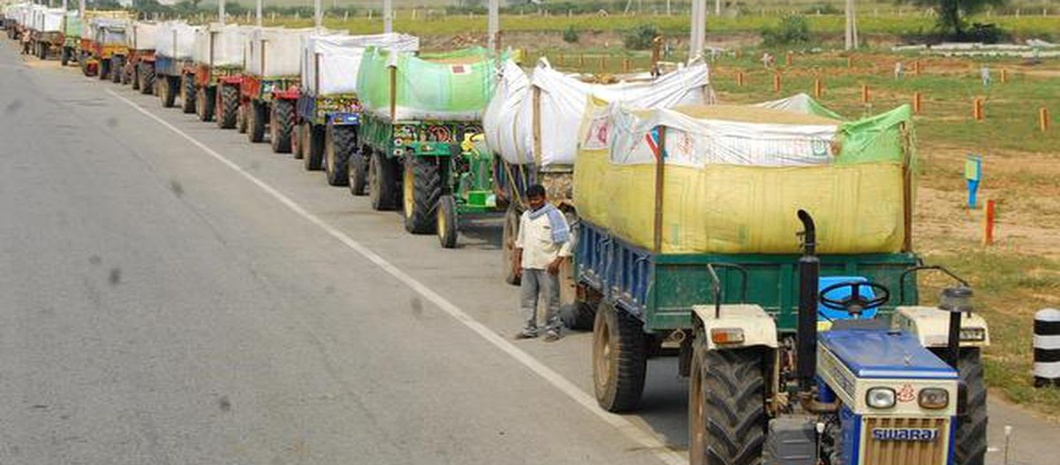
RESEARCH AND REFERENCES
Your Team Name
An article discusses the challenges Indian farmers face in selling crops

